Slide 1



Methodological issues and data gathering
Postgraduate Diploma in
Development Finance – Research Orientation
Dr Pieter Opperman

Slide 2
INTRODUCTION
Data gathering/collection is extremely important for no matter what data analysis method is used, analysis and interpretation cannot correct for bad data

Slide 3
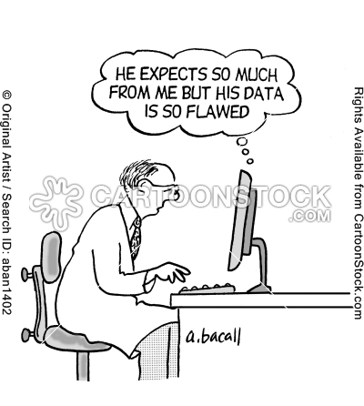
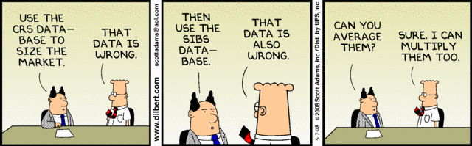
Always remember GIGO So you don’t beat the data to confess

Slide 4
INTRODUCTION TO RESEARCH
Aspects of scientific research:
Theory, data collection and data analysis
Theory deals with logical aspects of science and providing systematic explanations.
Data collection deals with observational aspects.
Data analysis examines the patterns in observations and where appropriate compares what is logically expected with what is actually observed.

Slide 5
THE METHODOLOGICAL QUESTION (QUANTITATIVE RESEARCH)
Posing variable oriented research questions/hypothesis
Using close-ended questions on instruments with scores that are reliable and valid
Employing statistical analysis – descriptive/inferential/regression analysis
Having scientific rigor through generalizability, replicability, validity, control, and lack of bias.

Slide 6
THE METHODOLOGICAL QUESTION (QUALITATIVE RESEARCH)
Explores a key concept – central phenomenon
Asks participants broad, general questions
Collects detailed participant views in the form of words or images
Collects data with reciprocity and respect in mind
Analyzes and codes the data for description and themes
Writes a report in a flexible structure
Emphasizes ideas

Slide 7
DATA IMPLICATIONS
Quantitative data sources-Numbers: E.g. surveys, opinion polls, other indicators
Qualitative data sources-Texts E.g. historical records, reports, media, interviews, observation, ethnographic texts
Quantitative and qualitative approaches should make use of both quantitative and qualitative data sources if appropriate and available

Slide 8
DATA ISSUES
Broad distinction can be drawn between primary and secondary data.
Primary data = data collected with a specific purpose in mind, i.e. for the needs of a particular research project.
Secondary data = data that was not gathered expressly for the immediate study, but still may address the research question.

Slide 9
DATA ISSUES
Data will depend on the purpose of the research.
Enquiry may require the collection of new data, referred to as primary data, or be able to use existing data, referred to as secondary data.
Sources of primary data include observation, focus groups, interviews, and the use of questionnaires. Collection for a specific project.
Take a long time to collect,
Be expensive

Slide 10
Primary Data … A census or a survey?
We need to decide whether to include
all people undertake a census
or take a selection sample
Census:
Representative! Mean, standard Deviation
prohibitively expensive,
prohibitively time consuming,
limit the possible depth of the enquiry
Designed survey can provide
the acceptable quality of results
at lower costs and
greater speed

Slide 11
Questionnaires in Surveys
Advantages
Sample large populations (cheap on materials & effort)
Efficiently ask a lot of questions
Disadvantages
Self-report is fallible (minor changes in question wording, question format, or question context can result in major changes obtained in results)
Response biases are unavoidable (any property of questions that encourages respondents to answer in a particular way)

Slide 12
Questionnaires in Surveys : Response biases
Relying on people’s memory of events & behaviors
Emotionalism
Recent effect bias
Routines are deceiving
Social desirability
People answer through a filter of what will make them look good
Yea-saying
Solution: vary the direction of response alternatives

Slide 13
Questionnaires in Surveys : General Survey Biases
Sampling – are respondents representative of population of interest? How were they selected?
Coverage – do all persons in the population have an equal change of getting selected?
2 basic approaches to sampling: probabilistic and non-probabilistic.
If the purpose of your research is to draw conclusions or make predictions affecting the population as a whole (as most research usually is), then you must a use probabilistic sampling approach.
On the other hand, if you're only interested in seeing how a small group, then you can use a non-probabilistic sampling approach.
Measurement – question wording & ordering can obstruct interpretation
Non-response

Slide 14
Questionnaires in Surveys : Design is KEY
Format – booklet, printed vertical, one-sided
Question ordering – earlier questions can prime answers to later questions
Page layout – group similar items & use consistent fonts and response categories
Pre-testing – conduct with volunteers demographically similar to expected participants

Slide 15
Questionnaires in Surveys : Common Problems
Avoid complicated & double-barrel questions
Complexity increases errors & non-response
African governments should reduce excess spending by reducing government size, cutting down on military expenditures, reduce ministerial perks and allowances and spend more on infrastructure development. Do you agree or disagree?
Navigation is paramount – make sure the survey is EASY to follow
Open-ended questions
The size of the field allotted will determine the number of words

Slide 16
QUSTIONNAIRES IN SURVEYS: MODES OF SURVEY ADMINISTRATION
Variable | Mail | Phone | F/F
Cost | Cheapest | Moderate | Costly
Speed | Moderate | Fast | Slow
Response rate | Low-moderate | Moderate | High
Sampling need | Address | Tel number | Address
Burden on respondent | High | Moderate | Low
Control participation | Unknown | High | Variable
Length of questionnaire | Short | Moderate | Long
Sensitive quest | Best | Moderate | Poor
Lengthy choices | Poor | Good | Best
Open-ended res | Poor | Good | Best
Complexity | Poor | Good | Best
Interviewer bias | None | Moderate | High

Slide 17
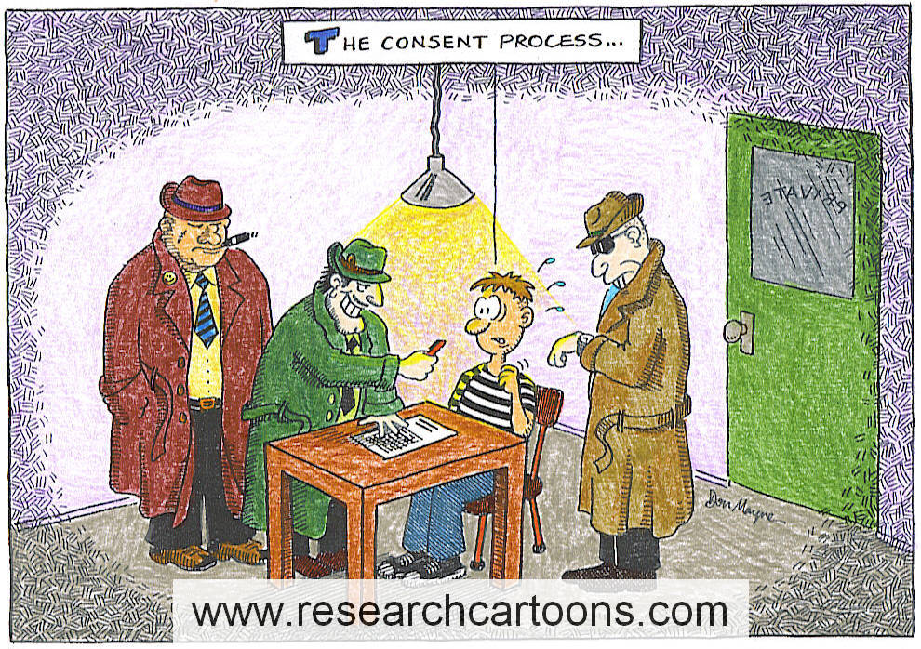
Ethical Issues in Social Research-consent in primary research
Voluntary Participation
No one should be forced to participate.
Informed Consent – a norm in which subjects base their voluntary participation in research projects on a full understanding of the possible risk involved.

Slide 18
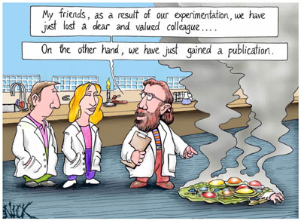
Harm and Anonymity
No Harm to the Participants
People being researched should never be injured (physically, mentally, emotionally, socially, psychologically).
Anonymity and Confidentiality
Anonymity – guaranteed in a research project when neither the researchers nor the readers of the findings can identify a given response with a given respondent.
Confidentiality – guaranteed when the research can identify a given person’s responses but promises not to do so publicly.

Slide 19
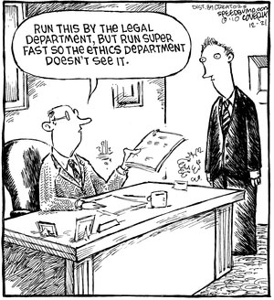
Ethical Issues in Social Research-SU sample
Deception
needs to be justified by scientific or administrative concerns.
Debriefing – interviewing subjects to learn about their experience of participation in the project.
Analysis and Reporting
Ethical obligation to colleagues in the scientific community.
All results must be reported (positive and negative).
All limitations must be admitted.
Institutional Review Boards – a panel of faculty who review all research proposals so that they can guarantee that the subjects’ rights and interests will be protected-done at proposal stage.

Slide 20
RESEARCH ETHICS
Deception: needs to be justified by scientific or administrative concerns. Debriefing – interviewing subjects to learn about their experience of participation in the project.
Analysis and Reporting: Ethical obligation to colleagues in the scientific community. All results must be reported (positive and negative). All limitations must be admitted.

Slide 21
RESEARCH ETHICS
Primary purpose of reviewing the ethics of research is to ensure rights, interests, privacy and dignity of research participants are protected.
Where participants are expected to make substantial sacrifices but the benefits to society are not clear, the research should be ethically questioned.
Clearing a study to proceed that unduly inflates the risk of invalid conclusions should be seen as unethical.

Slide 22
RESEARCH ETHICS
At SU all research involving interaction with or observation of human subjects, or information linked to human subjects, or research involving groups or individuals, or organisations must go through a process of ethical screening and clearance.
The Research Ethics Committee (REC) reviews projects considered medium- or high risk.
Low risk projects are directly approved by the Departmental Ethics Screening Committee (DESC) and do not need to be submitted through the REC.
Does my research qualify for exemption? Use the screening questions as a guide as to whether you need DESC/REC approval. If in doubt, consult your supervisor or a member of your department’s DESC.

Slide 23
CASE STUDY
An exploration or in-depth analysis of a “bounded system” (bounded by time and/or place OR single or multiple case over a period of time (Creswell, 1998).
The case that is being studied may refer to a process, activity, event, programme or individual or group or even refer to a period of time.
The exploration and description of the case takes place through detailed, in-depth data collection methods that involve multiple sources of information being rich in context.
Interviews, documents, observations or inspecting archival records.
The product of this type of research is an in-depth description of a case or cases and the researcher will situate this case(s) within its larger context, but the focus remaining on the case or the issue illustrated by it.

Slide 24
SAMPLING TECHNIQUES
Non-probability sampling: A sample selected in a way other than suggested by probability theory. Data not valid for statistical inference analysis. Cannot generalise.
Probability sampling: A sample selected in accord with probability theory usually involving some random-selection mechanism. Data valid for statistical inference analysis. Can generalise.

Slide 25
NON-PROBABILITY SAMPLING
Reliance on available subjects;
- Convenience sampling
- Does not allow for control over representativeness.
- Only justified if less risky methods are unavailable.
Purposive sampling or Judgmental Sampling
The units to be observed are selected on the basis of the researcher’s judgment about which ones will be the most useful or representative
Snowball sampling
Each person interviewed may be asked to suggest additional people for interviewing (When members of a special population are difficult to locate, e.g. migrant workers)

Slide 26
PROBABILITY SAMPLING
Simple random sampling
A single number is assigned to each unit on the sampling frame with a table of random numbers then used to select units for the sample.
Every possible unit has an equal chance/probability of being selected.
Benefit: Sample is unbiased.
Limitations: May be expensive and listing all members of the population may be impossible to do or be too time consuming and thus seldom used in practice.
Systematic sampling
Units on the sampling frame picked at a constant interval (“If the list contains 10 000 elements and you want a sample of 1 000, you select every 10th element for your sample.”)
Quicker and less expensive than simple random sampling.
Not strictly random and danger of bias.

Slide 27
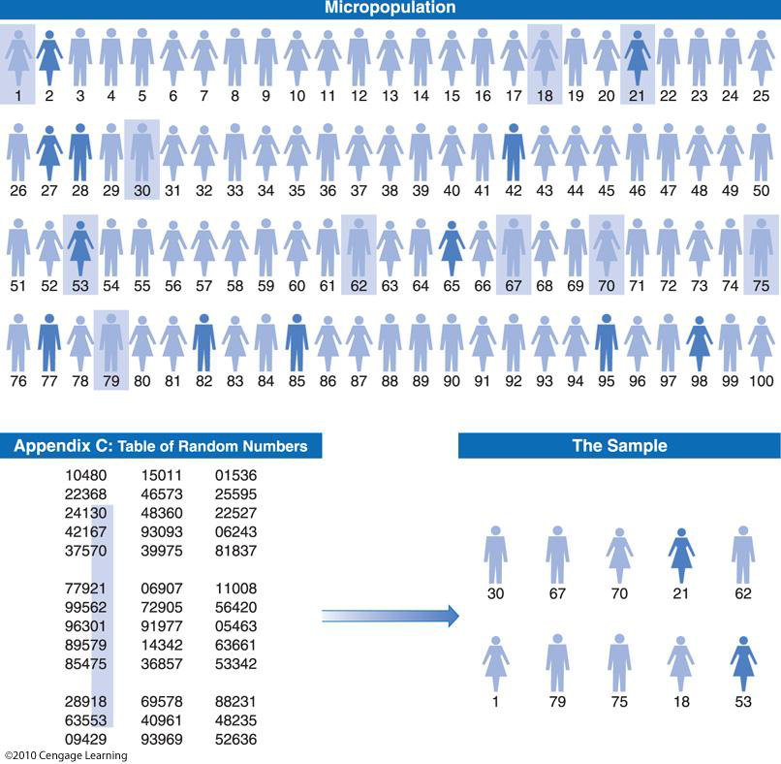

Slide 28
PROBABILITY SAMPLING (CONTINUED)
Stratified sampling
Population is separated in mutually exclusive sets/strata and then apply random or systematic sampling to each set/strata.
A sampling method used to obtain a grater degree of representativeness and can rather be seen as a modification in the use of random and systematic sampling.
Sampling error can be reduced increasing the sample size and a homogenous population would produce samples with smaller sampling errors than a heterogeneous population.
Requires prior information about the population which is not always easy.

Slide 29
PROBABILITY SAMPLING (CONTINUED)
Cluster sampling
Used when it is impossible or impractical to get an exhaustive list of the elements of a population.
Sampling of groups or clusters of elements (Distinct clusters but great variability within the clusters)
- Reduces cost
- Increases sampling error

Slide 30
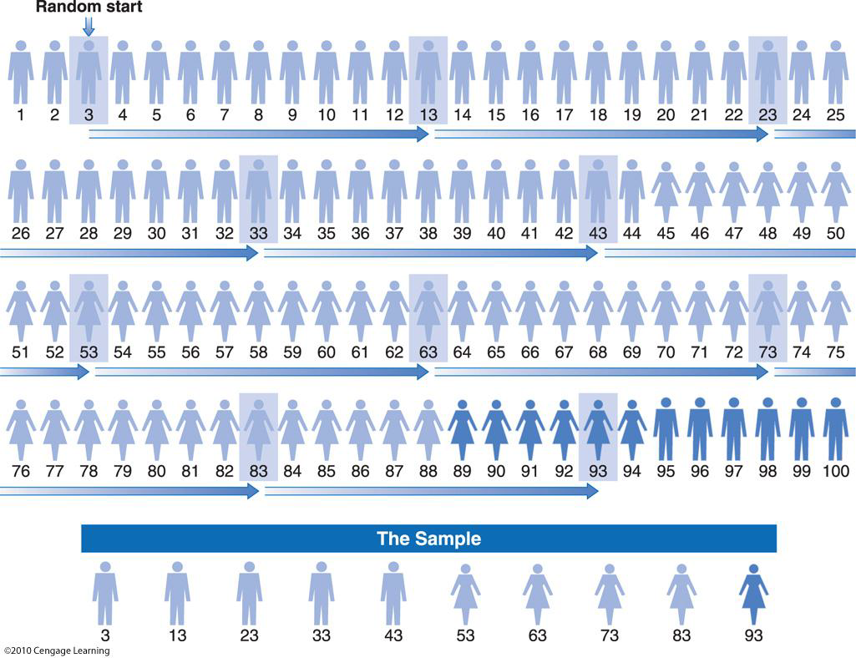

Slide 31
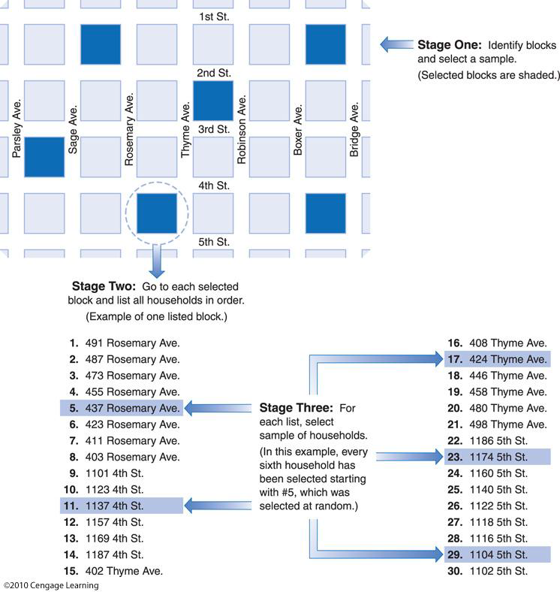

Slide 32
SECONDARY DATA
Data used for research that was not gathered directly and purposefully for the project under consideration.
Give thought to whether data may already exist to answer the research question.
Searching for existing data may save time, effort and expense in spite of the fact that the data may not have been originally collected with the current research question in mind.
Data gathered by stock markets, bond markets, national governments and international agencies such as the IMF and the World Bank are extensively used by econometric practitioners.

Slide 33
SECONDARY DATA
Make sure to spend enough time to thoroughly understand the secondary data employed in the study
Example 1 – IMF IFS data
Paper uses the same IFS series’ employed by Neumann ,et al., (2009), Mercado & Park (2011) and Broto, et al., (2011). 78bed (Direct investment in reporting economies n.i.e); 78bmd (Equity securities liabilities); 78bnd (Debt securities liabilities); 78bid (Other investment liabilities).
BPM5 methodology changed to BPM6 with new series codes
78bed – BFDLXF_BP6

Slide 34
SECONDARY DATA
Some Useful Data sources for Quant Data
http://data.worldbank.org/
http://www.datafirst.uct.ac.za/
http://research.mcgregorbfa.com.ez.sun.ac.za/Default.aspx
http://comtrade.un.org/monthly/Main/Data.aspx
http://www.imf.org/external/data.htm
http://unctadstat.unctad.org/ReportFolders/reportFolders.aspx
Central Banks
Statistical offices

Slide 35
ADDITIONAL SECONDARY DATA
World Bank Enterprise Surveys - Topics from a broad range of the business environment that include among others access to finance, corruption, crime and performance measures are covered by the surveys. According to Sahaym & Nam (2012) the purpose of these surveys are to capture the institutional environment that firms operate in and thus stimulate policy dialog regarding the business environment. The surveys were formerly known as Investment Climate Surveys (Wignaraja, 2012).

Slide 36
ADDITIONAL SECONDARY DATA
World Bank Global Financial Development Database - Data on financial system characteristics. The database developed several measures of the following four characteristics of financial systems (institutions and markets): (i) Financial depth; (ii) Financial access; (iii) Financial system efficiency; (iv) Financial system stability. Hence, four characteristics measured for institutions and markets that lead to a 4x2 matrix of characteristics (Cihak et al., (2012). These characteristics serve as proxies for the services that the financial system provides.

Slide 37
ADDITIONAL SECONDARY DATA
World Bank Global Financial Inclusion (Global Findex) database - Demirguc–Kunt & Klapper (2012) stated that the Global Findex is the first public database that would consistently measure the use of financial products across economies over time. It was further noted that it is important to differentiate between the use of financial services and access to financial services. The latter mostly refers to the supply of financial services with use being determined by both demand and supply. The first set of Global Findex indicators focuses on formal accounts; the second set focuses on savings, the third set on borrowing sources with the final set focussing on health care insurance products and agriculture (Demirguc–Kunt & Klapper, 2012).

Slide 38
ADDITIONAL SECONDARY DATA
World Bank Doing Business database - Annual Doing Business report measures the scope and manner of regulations, those enhancing and constraining, relevant to small and medium sized firms (World Bank, 2013). Regulations are measured that affect 11 areas of business activity (World Bank, 2013). These 11 indicator sets can be divided between “Complexity and Cost of Regulatory Processes” (six sets) and “Strength of Legal Institutions” (five sets). Included in the former set is “Starting a Business”, “Paying Taxes” and “Registering Property”. Included in the latter set are “Getting Credit”, “Protecting Investors” and “Enforcing Contracts”. The overall ranking of countries that make up the “ease of doing business” ranking covers 10 indicator sets and excludes the “Employing Workers” indicator set. In this year’s ranking (2013) South Africa lied 39th compared to 35th in 2012.

Slide 39
ADDITIONAL SECONDARY DATA
Class exercise – For each of the four aforementioned World Bank databases search for a few journal articles where the data from the from the database was used.

Slide 40
SECONDARY DATA TYPES
Cross sectional data : Data on one or more variables collected at a single point in time. E.g. loans by 200 microfinance institutions in Kenya in 2012 credit to government in 48 SSA countries in 2016.
Time series data: Data that have been collected over a period of time on one or more variables. E.g. inflation in Zimbabwe over the last 30 years.
Panel data: Data comprising both cross-sectional and time series elements. Importantly, a panel keeps the same units (individuals, households, firms, countries) and measures some quantity about them over time. E.g. inflation in 48 SSA countries from 1990-2012.

Slide 41
Use of Both Primary and Secondary Data Bradshaw (2002)
Secondary data - obtained from information provided to the California Trade and Commerce Agency and Economic Benefit Reports. (see further in article)
Primary – “…were unable to obtain this information from some firms in spite of repeated mail and telephone follow-up efforts.”
“To overcome some of these data difficulties, a random sample of firms was selected for follow up study. I selected 300 firms using a stratified sampling framework to select equal numbers of firms with paid-off loans (graduated) and those with active loans, as well as firms with 10 or fewer employees and those with 11 or more. A brief questionnaire was administered
Data were collected using a combination of initial mailings from their local corporations and intensive bilingual phone and fax follow-up from the University of California–Davis.
Overall, the survey achieved a 59% response from firms with adequate contact.”

Slide 42
IMPORTANCE OF THE LITERATURE IN INFORMING METHOD AND DATA
NB: The data and methods for all studies must be built around literature

Slide 43
Additional readings
Gil, N., Miozzo, M. & Massini, S. 2012. The innovation potential of new infrastructure development: An empirical study of Heathrow airport’s T5 project. Research Policy, 41, 452-466. (Methods section)
Case study approach
Interviews
Core interview questions provided as well as job roles of respondents

Slide 44
Additional readings
Blome, C. & Schoenherr, T. 2011. Supply chain risk management in financial crises-A multiple case-study approach. International Journal of Production Economics, 134,43-57. (Research Methodology)

